Slide 1
Histogram-based SVM for Semi-conductor classification

Slide 2

Table of Contents
Data Preparation
01
Methodology
02
Result
03
Review
04
histogram data of images
histogram-based SVM
metrics of model
reasons for failure

Slide 3
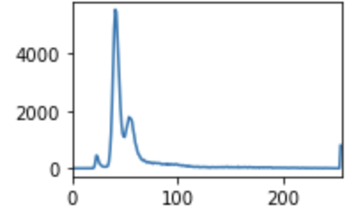
Data Preparation
256 bins Histogram data for Grey Scale images
Reasons for choosing
Histogram data:
It is computationally efficient
It is good for object classification task
Your logo

Slide 4
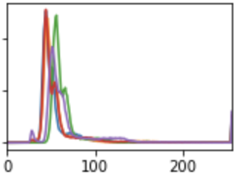
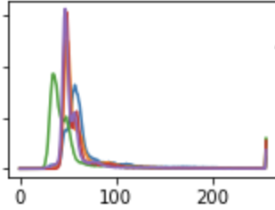
Good Semi-conductors
Defective Semi-conductors

Slide 5
2. Methodology
Binary SVM Model
Rbf kernel
8:2 split of train:test set

Slide 6
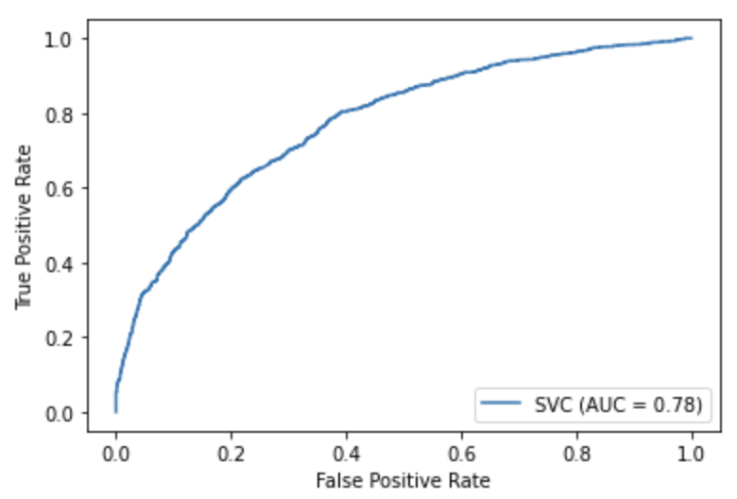
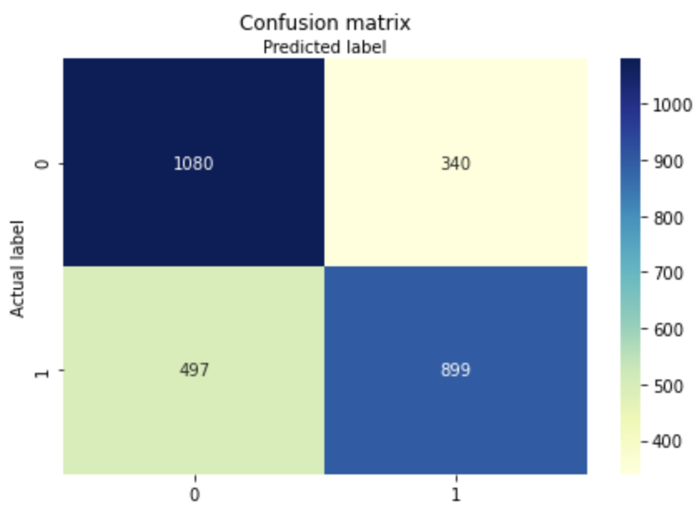
3. Result
Accuracy
0.7027698863636364
Precision
0.7255851493139629
Recall
0.6439828080229226

Slide 7
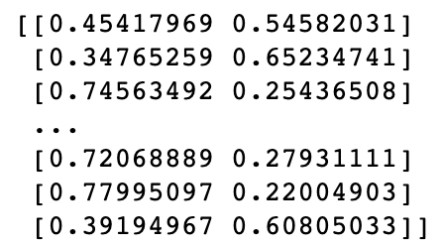
3. Validation Result
Kaggle Score: 0.20171
Prediction Probabilities:

Slide 8
4. Review
Not descriptive data feature
Not suitable Model
The RGB histogram is less descriptive than other histogram like HSV that includes brightness data
Histogram-based SVM is particularly useful for object classification instead of classifying non-distinct images

Slide 9
References
Chapelle, O, Haffner, P, & Vapnik, V.N. (1999). Support vector machines for histogram-based image classification. IEEE Transactions on Neural Networks, 10(5), 1055-1064.
Ahonen, T, Hadid, A, & Pietikainen, M. (2006). Face Description with Local Binary Patterns: Application to Face Recognition. IEEE Transactions on Pattern Analysis and Machine Intelligence, 28(12), 2037-2041.

Slide 10
Thanks
Q&A

